Slide 1
Microprocessor Architecture ECE4375 / ECE5375
Dr. Argenis Bilbao
Spring 2026

Slide 2
Presentation Outline
Parts of a CPU
Non-Pipelined CPUs
Pipelining
  Hazards introduction
Register File

Slide 3
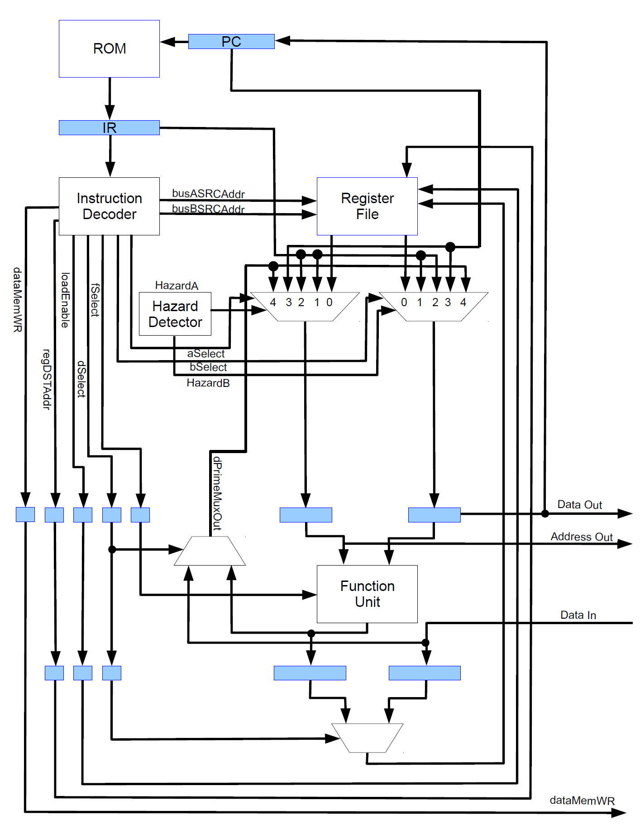
Basic Parts of a CPU
Datapath: Hardware that performs all required operations within a CPU
Control: Hardware that tells the datapath what to do to process the instructions
Decoder – Control
Arithmetic Logic Unit (ALU / FU) - Datapath
Register File – Datapath
Instruction / Data Memory – Datapath
Pipeline Registers – Datapath
(pipelined only)

Slide 4
Instruction Cycle
Fetch Stage: Next instruction if fetched from memory and placed in the instruction register (IR)
Decode Stage: Once in the IR a control word is generated to manipulate the datapath
Execute Stage: The ALU perform the required operation.
Writeback Stage: The results of the operation are written back into the register file.

Slide 5
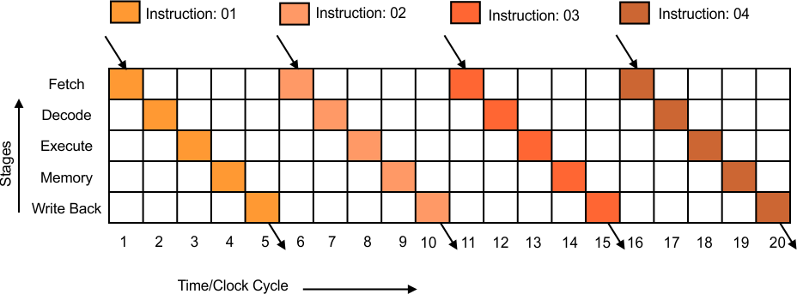
What is a Non-Pipelined/Sequential CPU?
A CPU that executes one instruction per clock cycle using a state machine
Does all the work in a single stage (a large one)
  Runs at relatively low frequencies
  Execution takes relatively larger number of cycles

Slide 6
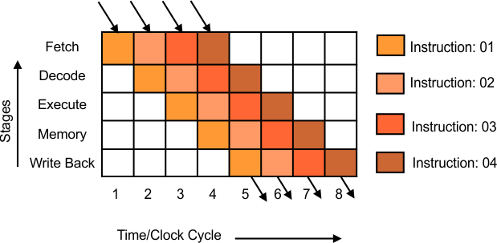
What is Pipelining?
Technique for implementing instruction-level parallelism within a single CPU
The objective is to ensure that all parts of a CPU are always in use
  Otherwise, it would be wasteful!
  Divide instructions into sequential steps
  These steps are performed by different CPU components
  Different instruction parts are processed in parallel
Not to be confused with:
Multi-threading
Multi-processing (multiple CPUs)
Multi-core
Superscalar design

Slide 7
Pipelining Advantages
Increased CPU utilization
Higher clock rates
Execution rate equal to 1 instruction per cycle
  Higher instruction throughput
More stages equates to more instructions processed in parallel
  Also allows higher frequencies

Slide 8
Pipelining Disadvantages
Increased complexity (in some ways)
Increased latency with increased stages
Increased design complexity
Pipelining introduces hazards! (more on this later)
  Structural hazards
  Data hazards
  Control hazards

Slide 9
Hazards?
Hazards
  Situations that prevent the next instruction from executing in its designated clock cycle
Structural Hazards
  When two different instructions want to use the same hardware resource in the same cycle (resource conflict)
Data Hazards
  When an instruction depends on the result of a previous instruction that exposes overlapping of instructions
Control Hazards
  Pipelining of PC-modifying instructions (branch, jump, interrupts!)

Slide 10
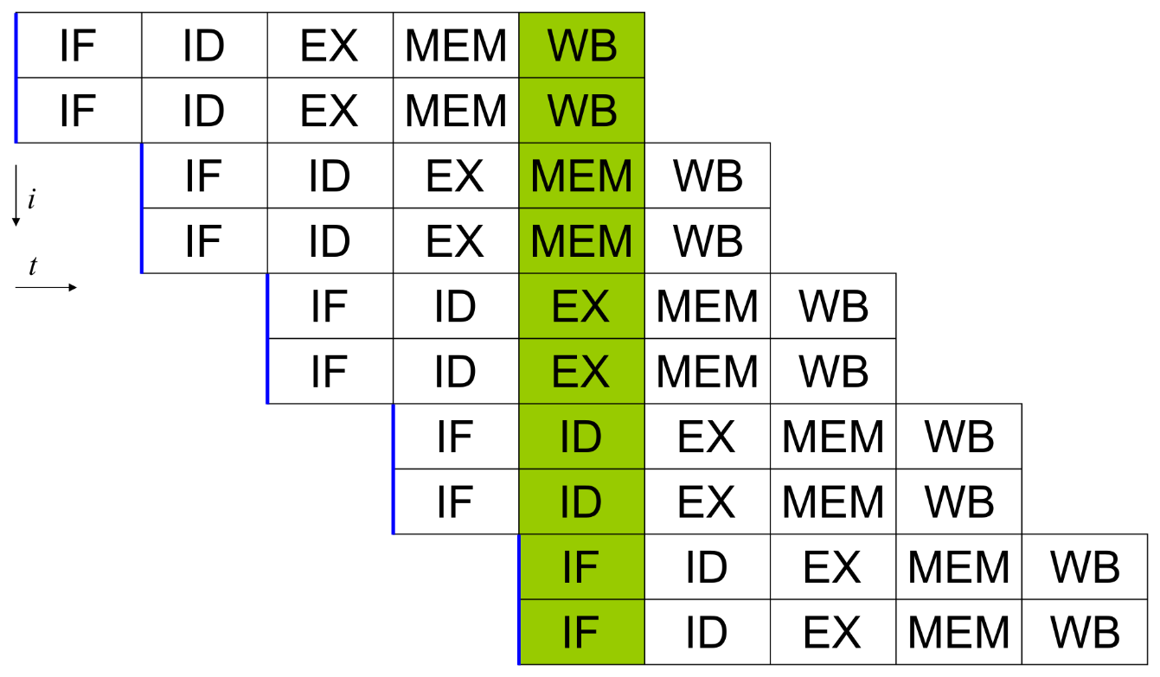
Structural Hazards
When two or more instructions in the pipeline require the use of the same resource (superscalar CPU)
  Instructions must then be executed in series
  Example: Two instructions add and subtract are in the execute stage. They both need the ALU to execute.

Slide 11
Data Hazards
When instructions that enter the pipeline have data dependencies
  Read After Write (RAW)
    Example: (inst. 2 tries to read R2 before inst. 1 writes to it)
    add R2, R5, R3
    add R4, R2, R3
  Write After Read (WAR) - superscalar
    Example: (inst. 2 tries to write to R5 before it is read by inst. 1)
    add R4, R1, R5
    add R5, R1, R2
  Write After Write (WAW) – superscalar
    Example: (inst. 2 tries to write to R2 before it is written by inst. 1)
    add R2, R4, R7
    add R2, R1, R3

Slide 12
Control/Branch Hazards
When CPU makes wrong branching predictions
  Results in filling the pipeline with incorrect instructions
  Pipeline must then be flushed
Example
  LD R1, #0x0002
  LD R2, #0
Loop:
  INC R2
  DEC R1
  BNZ Loop
  ST R2, &0x1000
  ST R1, &0x2000
Right
…
Wrong
…
ST R1, &0x2000
ST R2, &0x1000
BNZ Loop
DEC R1
INC R2
BNZ Loop
DEC R1
INC R2
LD R2, #0
LD R1, #0x0002
ST R1, &0x2000
ST R2, &0x1000
BNZ Loop
DEC R1
INC R2
LD R2, #0
LD R1, #0x0002

Slide 13
Resolving Structural Hazards
Stall / Bubbles – Low Cost, Simple (+)
  Increases CPI (-)
  Try to use for rare events in high-performance CPUs
  Remember NOPs?
Duplicate Resources
  Decreases CPI (+)
  Increases cost (area), possibly cycle time (-)
  Use for cheap resources, frequent cases

Slide 14
Resolving Data Hazards
We have a couple of choices…..
Stall whenever we have a RAW
  Huge performance penalty, dependencies are common!
Use Bypass/Forwarding to minimize the problem
  Data is ready by end of EXE (Add) or MEM (Load)
  Basic idea:
    Add comparator for each combination of destination and source registers that can have RAW hazards
    Add muxes to datapath to select proper value instead of register file
  Only stall when absolutely necessary
Schedule the instructions!!!!

Slide 15
Resolving Data Hazards
My CPU used a 2-to-1 multiplexor to
forward the output of the function unit
to the next instruction in the pipeline
if needed.
Additionally, the same multiplexor
forwards the result of a memory
operation to the next instruction if
needed.

Slide 16
Resolving Control Hazards
Stall the pipeline until result is known.
  Very bad with deep pipelines!
Have adder (additional hardware) in the instruction decode (ID) stage
  Additional cost
  Additional complexity in the ID stage leads to added propagation delays negating some of the benefits of pipelining
Use some sort of branch prediction hardware
  On average
    67% of conditional branches are taken
    60% of forward branches are taken
    85% of backward branches are taken
    (loops)
    100% of unconditional branches are taken

Slide 17
What About Interrupts?
Interrupts occur mainly due to factors that are external to the CPU
  Their occurrence can not be predicted
  CPU must execute code pointed to by the interrupt vector table (IVT)
Two options:
  Flush the pipeline and set PC to the required address to begin execution
    Fastest interrupt servicing (less interrupt delay)
  Allow instructions in pipeline to finish execution and then set PC to the required address to begin execution
    Slowest interrupt servicing (more interrupt delay)

Slide 18
Multi-Cycle Operations
Basic RISC pipeline
  All operations take 1 cycle
Unfortunately, not the case in real processors
  FP add, Integer/FP Multiply can be 2-6 cycles
  20-50 cycles for integer/FP divide, square root
Difficulties
  Hard to pipeline
  Differ in number of clock cycles
  Number of operands varies

Slide 19
Multi-Cycle Operations
For example, longer latency in FP unit
EX may continue for as long as FP takes to finish
Assume four separate ALUs (Superscalar)
  Integer unit
  FP/Integer Multiplier
  FP Adder
  FP/Integer Divider
Instruction stalls all instruction behind it if it can not proceed to EX

Slide 20
Instruction Scheduling
Scheduling tries to re-arrange instructions to improve performance
Two Types of scheduling methods: Static and Dynamic Scheduling
In static scheduling, the compiler / programmer arranges instructions to better utilize CPU resources and avoid hazards.
With dynamic scheduling the CPU hardware re-arranges instructions at runtime to reduce stalls and maximize hardware utilization
  Why hardware and not compiler?
    Code Portability
    More information available dynamically (run-time)
    Not everyone uses “gcc –O3”

Slide 21
Instruction Level Parallelism (ILP) and Scheduling
ILP drives a lot of CPU architecture research
  ILP requires Dynamic instruction scheduling. Examples of dynamic scheduling algorithms are:
    Scoreboarding
    Tomasulo’s Algorithm
  Superscalar / Multiple instruction issue
  Hardware Speculation
All of these things work well together

Slide 22
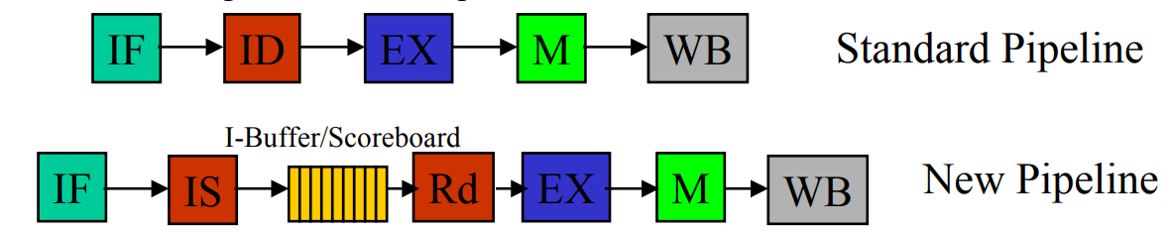
Scoreboarding
Divide the Instruction Decode (ID) stage into two stages, Issue and Read Operands.
Fetch – Nothing changes
Issue: In this stage we decode the instruction and check for structural hazards
  If we have a structural hazard, stall the instruction.
    Stalled instruction sits in the instruction buffer.
    Executable instructions move down the pipeline.
  Size of buffer is also a structural hazard.

Slide 23
Scoreboarding
Read Operand Stage: Here we now check for data hazards.
  Check scoreboard to see if source operands are available
  Are source operands available?
    Check to ensure that no other early instructions will write to the source registers.
    Check to ensure none of the ALUs / function units will write to the source registers.
  Dispatch when hazards are cleared.

Slide 24
Sources
http://www.eecs.harvard.edu/cs146-246/
Assigned Textbook
https://en.wikipedia.org/wiki/Instruction_pipelining
https://cstaleem.com/pipelining-and-non-pipelining
https://www.cise.ufl.edu/~mssz/CompOrg/CDA-proc.html#:~:text=Processor%20(CPU)%20is%20the%20active,%2C%20registers%2C%20and%20internal%20buses.
https://en.wikipedia.org/wiki/Superscalar_processor

